Slide 1
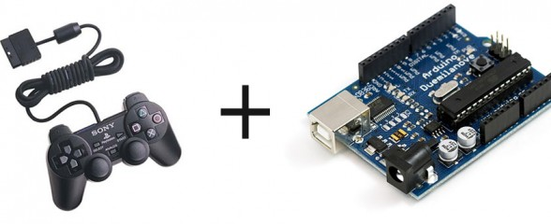
Interfacing Ps2 with Arduino

Slide 2
PS2 Controller - Simple Outline
The PlayStation brand is a series of video game consoles created and developed by Sony Computer Entertainment.
The PS2 controller consists of 4 main select buttons ‘Triangle’, ‘Circle’, ‘Cross’ and Square, start, select, a D-pad, shoulder buttons ( L1, L2, R1, R2 ) and 2 analog sticks with Dual shock feature. All the buttons are pressure-sensitive except start and select.

Slide 3
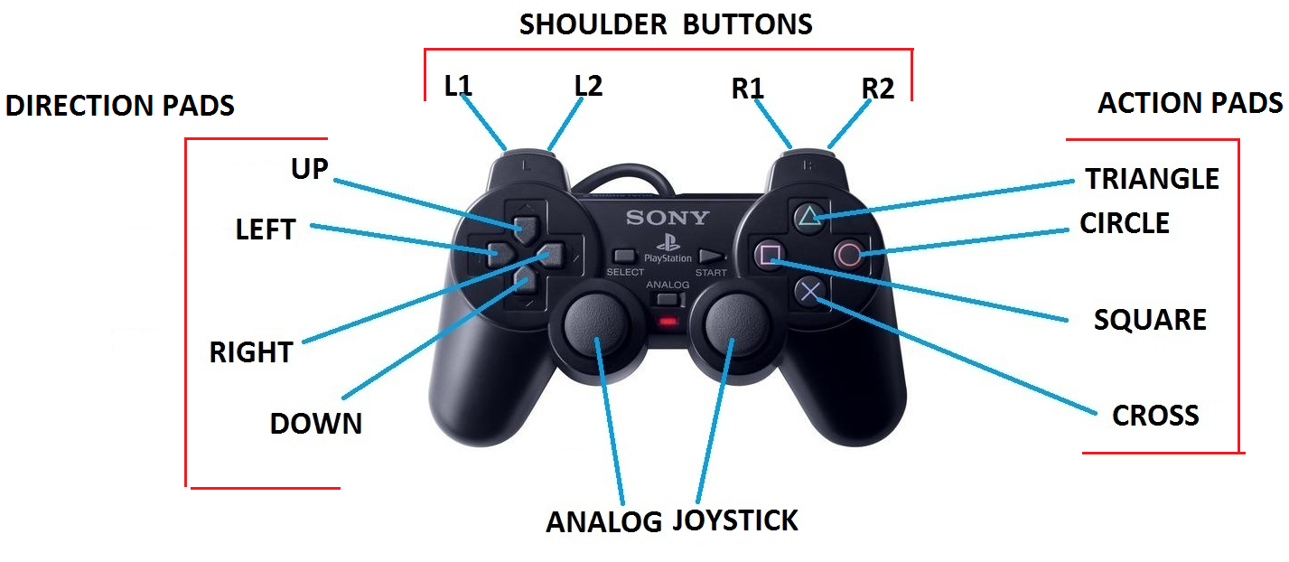

Slide 4
How is pressure-sensitivity achieved?
Whenever a button is pressed, a small disc attached to the bottom of the button is pushed against the conductive strip mounted on the circuit board of the controller.
With increase in pressure applied over the button, area of the disc touching the strip is increased and so there is an increase in conductivity leading to increase in flow of current.
Thus, the buttons are made pressure-sensitive
Notes:
http://www.howstuffworks.com/ps23.htm

Slide 6
Analog Joysticks
Newer Dual Shock PSX controllers have analog joysticks on them, as well as the standard buttons.
These joysticks work in a completely different way from the buttons described above.
Two potentiometers (variable resistors) are positioned at right angles to each other below the joystick. Current flows constantly through each one, but the amount of current is determined by the amount of resistance.

Slide 7
Resistance is increased or decreased based on the position of the joystick.
By monitoring the output of each potentiometer, the PSX can determine the exact angle at which the joystick is being held, and trigger the appropriate response based on that angle.

Slide 9
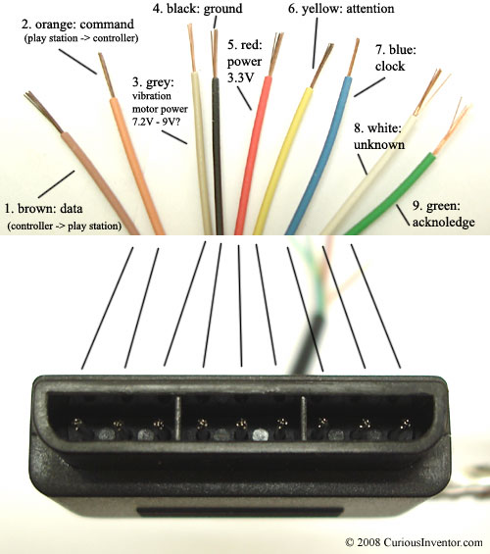

Slide 10
there are discussions over whether or not the controllers are tolerant of 5V logic. I’ve never had one burn out, so I believe they can handle “receiving’ 5V, but they still won’t ‘send’ 5V to the Arduino. It seems to me the one fix that seems to work the most is adding a 10k resistor between DATA (brown wire, or pin 1 on the controller port) and VCC (try both 3.3V and 5V in that order) on the Arduino.
This will help ‘pull-up’ the data line. Also there’s disagreement on what voltage to use to power the controller. A PlayStation powers the controller at 3.4V. I have always powered my controllers at 5V and had no problems, but it is risky. Controllers are so cheap on ebay though, why not try it? Try different voltages for power, switch between 3.3V and 5V, and for each voltage try it with and without the pull-up resistor on the DATA line

Slide 11
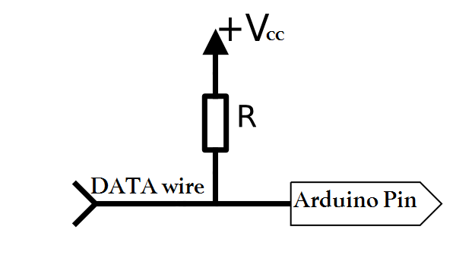
Pull up Resistors

Slide 12
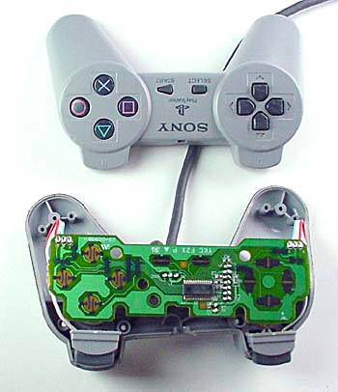

Slide 13
